Slide 1

White Wine Quality Analysis Using Aggregation Functions
SIT718 Assessment 2 - Real World Analytics
Student: Krishna Chaudhari
Student ID: s223751702
Course: SIT718 - Real World Analytics
Assessment: Assessment 2

Slide 2



Chapter 1
Research Objectives
Our primary objective is to predict white wine quality based on its physicochemical properties. Using a robust dataset and advanced aggregation functions, we aim to build a predictive model that offers valuable insights into wine quality assessment.
Problem Statement
Dataset Overview
Modeling Goal
Predict white wine quality based on physicochemical properties from a dataset of 4,897 white wine samples from Portugal.
The dataset includes 6 physicochemical properties (X1-X6) as input variables and Quality (Y) as the target variable.
Develop and evaluate predictive models using various aggregation functions to determine optimal wine quality.

Slide 3
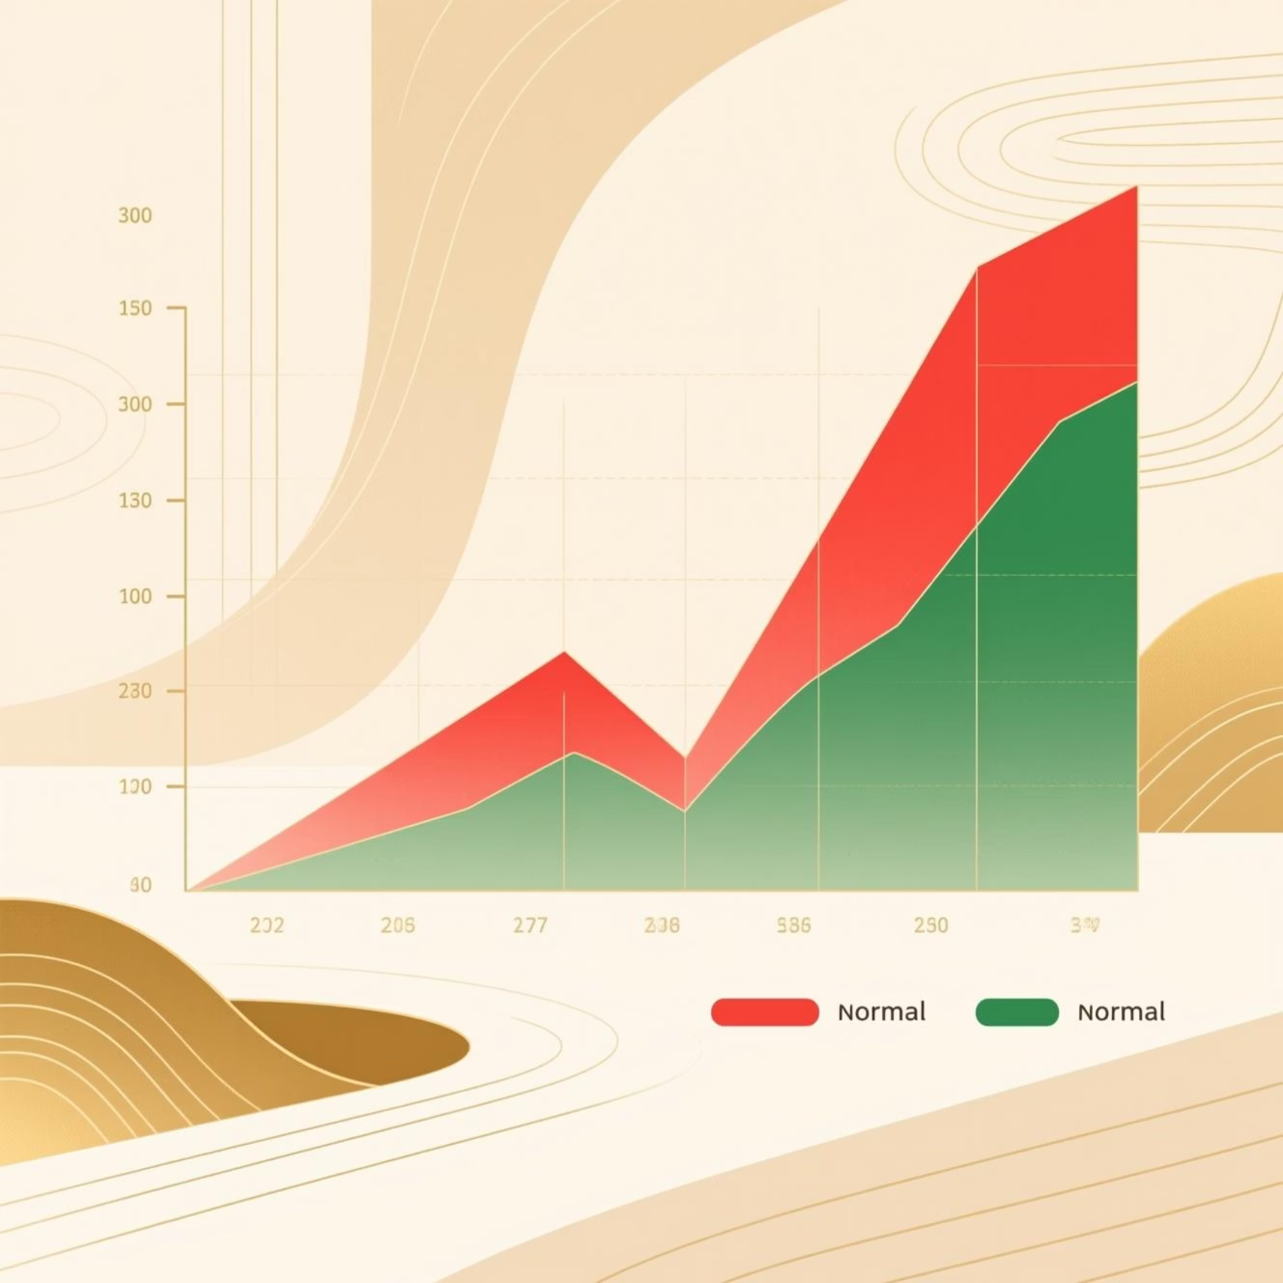
Chapter 2
Understanding Data Distribution
Analyzing the raw data characteristics revealed distinct distributions for each physicochemical property, crucial for understanding their impact on wine quality. Most variables exhibited skewness, while alcohol content showed a near-normal distribution.
Variable
Characteristics & Range
Skewed distributions can adversely affect model performance, often requiring transformation for better linearity and normality.
X1 (Fixed Acidity)
Right-skewed, 4.6-15.9
X2 (Volatile Acidity)
Right-skewed, 0.08-1.1
X3 (Residual Sugar)
Highly right-skewed, exponential-like
X4 (Free SO2)
Right-skewed, 2-289
X5 (Total SO2)
Right-skewed, 9-440
X6 (Alcohol)
Near-normal, 8.0-14.2
Y (Quality)
Discrete, scores 3-9

Slide 4




Chapter 3
Variable Selection & Transformation
To improve model accuracy, we selected key variables and applied specific transformations to reduce skewness and normalize their distributions. These adjustments ensure that the data aligns better with the assumptions of our predictive models.
1
2
X1: Fixed Acidity
X2: Volatile Acidity
Log Transformation (reduces skewness)
Square Root Transformation (reduces skewness)
3
4
X3: Residual Sugar
X6: Alcohol
Log(x+1) Transformation (handles exponential distribution)
Power Transformation p=0.5 (reduces skewness)
Rationale: These variables show stronger relationships with quality and benefit most from transformation, leading to more reliable predictions.

Slide 5

Chapter 4
Transformation Results
The applied transformations significantly reduced the skewness of our key variables, bringing them closer to normal distributions. Following this, all variables were normalized to a [0,1] range using min-max scaling to ensure consistency for model input.
Variable
Skewness Before Transformation
Skewness After Transformation
Fixed Acidity (X1)
1.2
0.3
Volatile Acidity (X2)
2.1
0.8
Residual Sugar (X3)
3.5
0.9
Alcohol (X6)
0.9
0.4
Normalization Formula
All variables were normalized to a [0,1] range using min-max scaling.

Slide 6
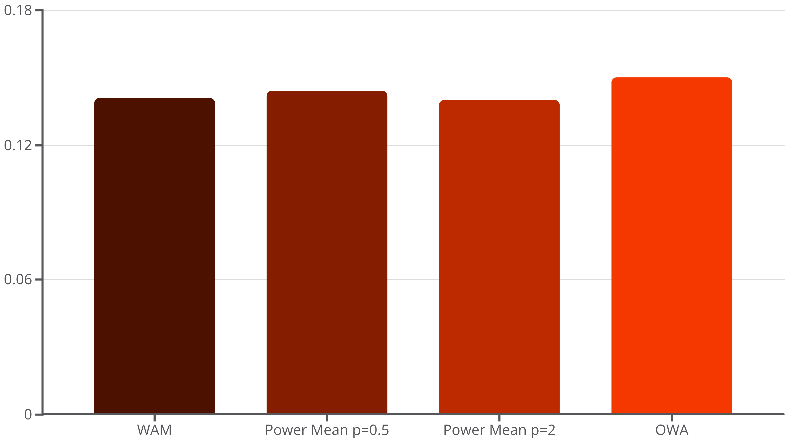
Chapter 5
Model Performance Comparison
We evaluated several aggregation function models based on key error measures and correlation coefficients.
The objective was to identify the model that demonstrates the highest predictive accuracy and strongest correlation with actual wine quality.
Model
RMSE
Avg Abs Error
Pearson Corr
Spearman Corr
WAM
0.141
0.110
0.400
0.411
Power Mean p=0.5
0.144
0.112
0.380
0.393
Power Mean p=2
0.140
0.109
0.400
0.410
OWA
0.150
0.118
0.212
0.210

Slide 7

Chapter 6
Best Model & Variable Importance
The Power Mean p=2 model emerged as the top performer, delivering the lowest errors and highest correlations. Analysis of its weights revealed alcohol content and residual sugar as the most significant predictors of white wine quality.
Key Finding
Alcohol content (47.1%) is the most important factor, followed closely by residual sugar (35.8%) in determining white wine quality.
The Power Mean p=2 model effectively highlights the critical physicochemical properties influencing overall wine quality.
X1 (Fixed Acidity)
X2 (Volatile Acidity)
X3 (Residual Sugar)
X6 (Alcohol)

Slide 8
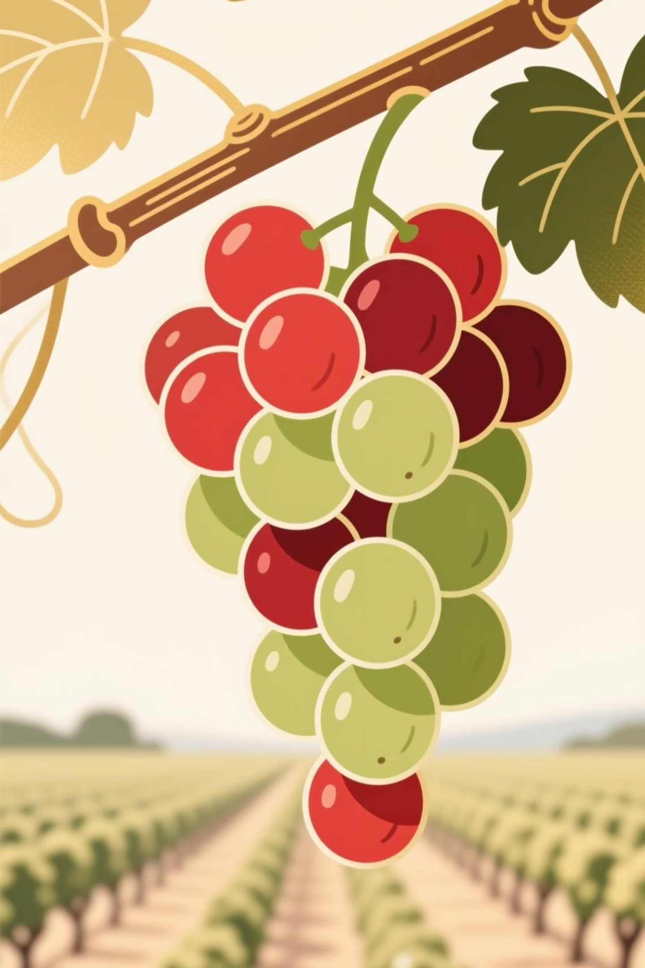
Chapter 7
Why These Variables Matter
The importance of alcohol and residual sugar is not surprising, as they directly contribute to the body, sweetness, and overall balance of wine. Fixed acidity provides crucial structure, while volatile acidity's minimal impact suggests it may be a less reliable quality indicator in this context.
1. Alcohol (X6): 47.1% Weight
Higher alcohol often indicates better fermentation
Correlates strongly with wine body and complexity
2. Residual Sugar (X3): 35.8% Weight
Affects wine sweetness and balance
Critical for white wine character
3. Fixed Acidity (X1): 17.1% Weight
Provides structure and freshness
Essential for wine stability
4. Volatile Acidity (X2): 0% Weight
Shows minimal impact on quality prediction
May indicate data redundancy or minimal contribution

Slide 9

Chapter 8
Optimal Conditions & Prediction
Based on our model, we've identified optimal ranges for key physicochemical properties that correlate with higher white wine quality.
Using these insights, we can predict the quality score for new wine samples and provide guidance for winemaking.
Best Conditions for Higher Quality Wine
Prediction Results
Alcohol Content (X6): 12-13% (higher fermentation quality)
Residual Sugar (X3): 2-5 g/L (balanced sweetness)
Fixed Acidity (X1): 6-8 g/L (proper structure)
Volatile Acidity (X2): <0.3 g/L (minimal defects)
Input Values:
X1 = 6.7 (Fixed Acidity)
X2 = 0.18 (Volatile Acidity)
X3 = 4.7 (Residual Sugar)
X4 = 57 (Free SO2)
X5 = 161 (Total SO2)
X6 = 10.5 (Alcohol)
Target Quality Range: 7-9/10
Predicted Quality: 6/10
Reasonableness Assessment:
Moderate acidity (6.7) is typical for white wines
Low volatile acidity (0.18) is good
Moderate sugar (4.7) provides balance
Good alcohol content (10.5%) indicates proper fermentation

Slide 10

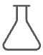

Conclusion
Key Takeaways & Future Directions
Key Findings:
Practical Applications:
Power Mean p=2 is the best predictive model.
Wine Quality Assessment
Alcohol content (47.1%) is the most important quality predictor.
Residual sugar (35.8%) is the second most important.
For producers and quality control.
Model accuracy: RMSE = 0.140, Correlation = 0.400.
Prediction: Input wine quality = 6/10.
Winemaking Process
Guidance for optimal conditions.
Consumer Guidance
Informed wine selection.
References & Acknowledgments
References:Cortez, P., Cerdeira, A., Almeida, F., Matos, T. and Reis, J. (2009). Modeling wine preferences by data mining from physicochemical properties. Decision Support Systems, Elsevier, 47(4), 547-553.
Packages Used: R base packages, lpSolve package for optimization
Acknowledgments: Deakin University, AggWaFit718.R functions

